Slide 1




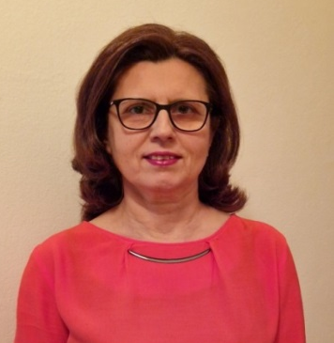

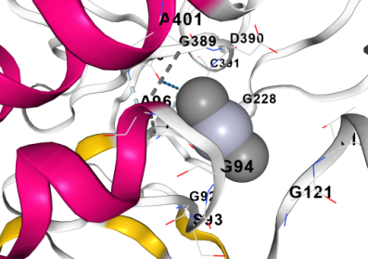
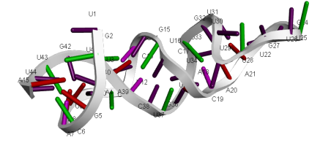
Molecular and Bioinformatics Innovations in Animal Health (MBIAH)
Contact person/Group leader:
Akad. Prof. Dr. Anila HODA
Affiliation
Academy of Sciences of Albania
Mail address
Sheshi Fan S. Noli, , Tirana, Albania
Email
anila.hoda@akad.gov.al
Group Members
Akad. Prof. Dr. Anila Hoda; Prof. Dr. Mirela Lika; Prof. Dr. Xhelil Koleci; Prof. Asoc. Dr. Valbona Kolaneci
Google Scholar
‪‪Anila Hoda‬ - ‪Google Scholar‬
Research Gate
Anila Hoda (researchgate.net)
Research lines
Enhance diagnostic capabilities using molecular techniques.
Introduce Oxford Nanopore and NGS technology for various research applications.
Develop novel therapeutics through structure-based drug design.
Utilize in silico techniques for drug design optimization.
Integrate immunobioinformatics for vaccine and immunotherapy development.
Promote the One Health approach for interconnected human, animal, and environmental health.

